Slide 1


ESTD:2009
CMR TECHNICAL CAMPUS
(UGC AUTONOMOUS)
Accredited by NBA & NAAC with ‘A’ Grade
Approved by AICTE, New Delhi and JNTU, Hyderabad
Kandlakoya, Medchal Road, Hyderabad- 501 401, Telangana
Department of CSE
Multi-Disease Detection System With X-Ray Images Using Deep Learning Techniques
Under the Guidance of
Dr. J. NARASIMHARAO
(Associate Professor)
Project coordinator:
Dr. J. NARASIMHARAO
(Associate Professor)
Group Members:
B.Meghana (217R1A05L2)
N.Manoj Kumar (217R1A05P2)
G.Amruthavarshini(217R1A05N0)

Slide 2
Contents
Abstract
Existing System
Disadvantages
Proposed System
Advantages
Hardware and Software Requirements
Novelty of the Project
Architecture
Modules
UML Diagrams
Conclusion
Future Scope

Slide 3
Abstract:
This project presents a multi-disease detection system that utilizes deep learning techniques to analyze X-ray images for the identification of various medical conditions, including pneumonia, tuberculosis, and fractures.
By leveraging a comprehensive dataset of labeled X-ray images, we implement convolutional neural networks (CNNs) and explore transfer learning with pre-trained models to enhance classification accuracy.
This project underscores the importance of integrating artificial intelligence into clinical workflows to enhance diagnostic efficiency while adhering to healthcare regulations and ethical standards.

Slide 4
Existing System:
One notable system is CheXNet , which employs a deep convolutional neural network to achieve radiologist-level accuracy in pneumonia detection, utilizing a dataset of over 100,000 chest X-ray images.
Cohenetal showcased a model specifically for detecting COVID-19, illustrating the adaptability of deep learning systems in addressing urgent healthcare challenges.
These existing systems highlight the potential of deep learning in medical imaging.
The effectiveness of various CNN architectures in detecting pneumonia, concluding that deeper networks significantly improve diagnostic performance compared to traditional methods

Slide 5
Disadvantages of Existing System:
Data Requirements
Requires large, labeled datasets for training.
Obtaining these datasets can be difficult and expensive.
Image Quality Dependency
Performance depends heavily on the quality of images in the dataset.
Cost and Time Constraints
Training and data collection are time-consuming.
The process can be costly to produce.

Slide 6
Proposed System:
Develops a deep learning framework for multi-disease detection using X-ray images.
Uses transfer learning (ResNet, EfficientNet) for better performance with limited data.
Incorporates Grad-CAM for visualization to enhance model transparency.
Improves diagnostic accuracy, reduces radiologists' workload, and enhances patient care.

Slide 7
Advantages of Proposed System:
Adaptability to Emerging Diseases
Enables detection of new diseases with minimal retraining.
Transfer Learning Efficiency
Utilizes pre-trained models (ResNet, EfficientNet) for improved performance
with limited data.
Reduced Need for Specialist Intervention
Assists in automated diagnosis, reducing dependency on medical experts.
Early and Accurate Diagnosis
Enhances detection speed and precision for timely medical intervention.

Slide 8
kuyjhsg
kjlkjgg
Hardware and Software Requirements:
HARDWARE REQUIREMENTS :
System : Pentium IV 2.4 GHz..
RAM : 512 MB.
Hard Disk : 40 GB.
SOFTWARE REQUIREMENTS :
Operating System : Windows 8 or Above.
Coding Language : Python(3.7.4).

Slide 9
Novelty of the Project:
Multi-Disease Classification – Unlike traditional models that focus on a single disease, this system can detect multiple diseases from a single X-ray image, improving diagnostic efficiency.
Real-Time Diagnosis with High Efficiency –The system is optimized for real-time performance ,which is crucial for timely medical interventions.
Early Detection of Multiple Diseases – Capable of detecting diseases at an early stage, improving treatment outcomes for conditions like pneumonia, tuberculosis, or lung cancer.
Systems Integration with Healthcare – Potential to be integrated with existing hospital management systems for seamless workflow and data handling.

Slide 10
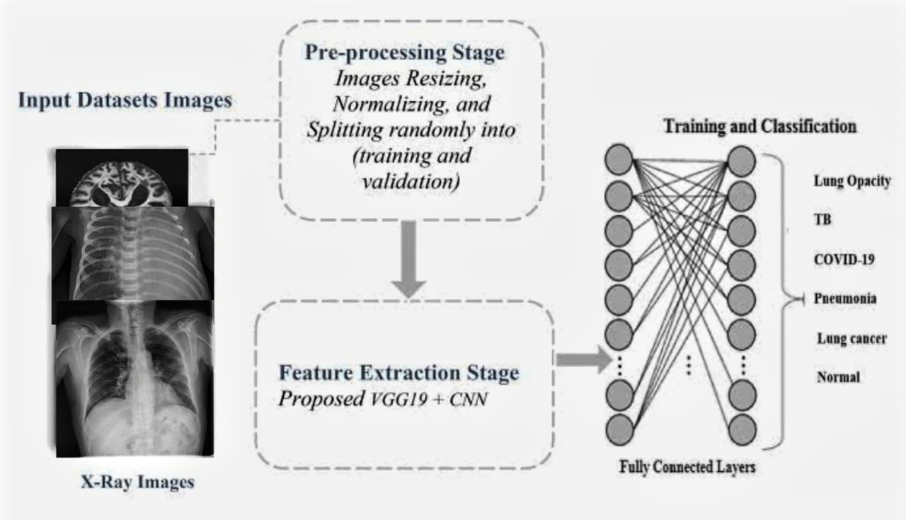
Architecture:

Slide 11
Modules:
Upload X-Ray Images Dataset: Upload x-ray images dataset to the application.
Preprocess dataset: Preprocess and extract x-ray images and then shuffle and split dataset where application using 80% dataset for training and 20% for testing.
Run VGG16 and VGG19 Algorithms: Input 80% training data to VGG16 and VGG19 to train a model and this model will be applied on test data to calculate prediction accuracy.
Comparison graph: Plot accuracy graph between both algorithms.
Tumor detection: Upload test image dataset to application to extract x-ray images and then predict weather image is normal or any diseases are detected.

Slide 12
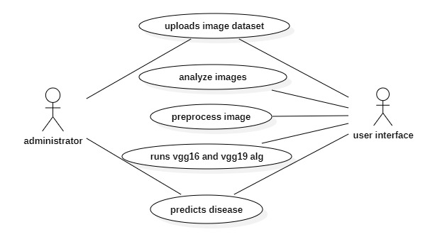
Usecase Diagram:

Slide 13
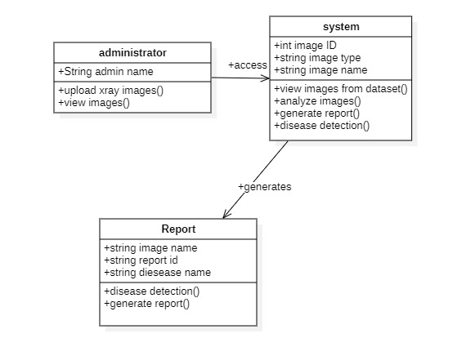
Class Diagram:

Slide 14
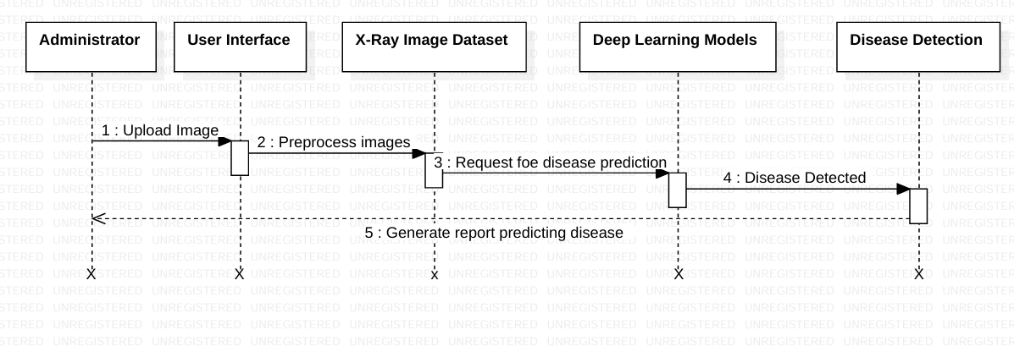
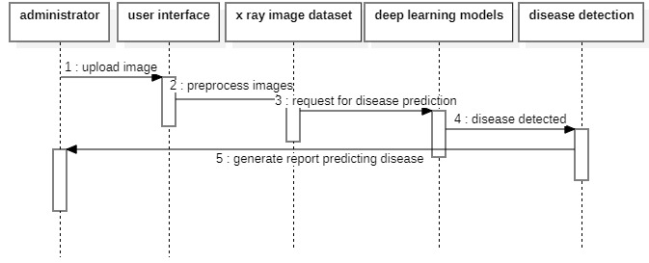
Se
Sequence Diagram:

Slide 15
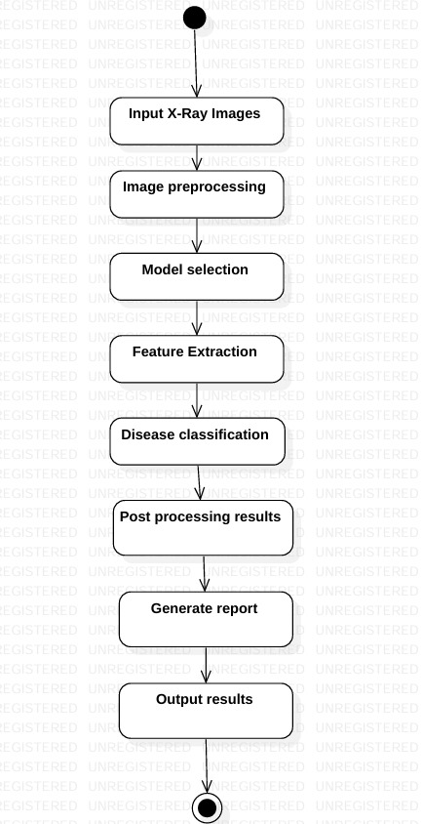
Se
Activity Diagram:

Slide 16
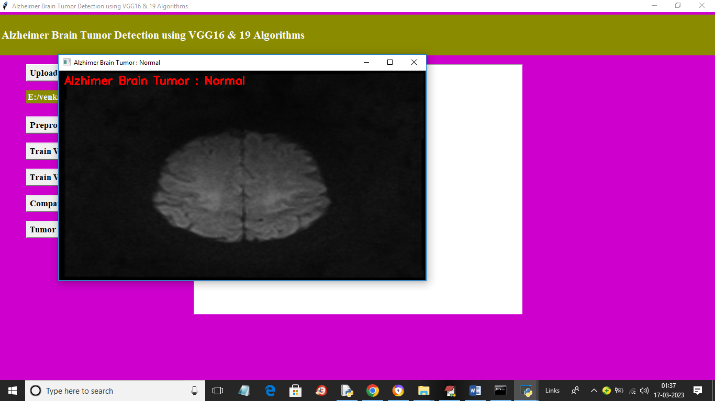
Results:

Slide 17
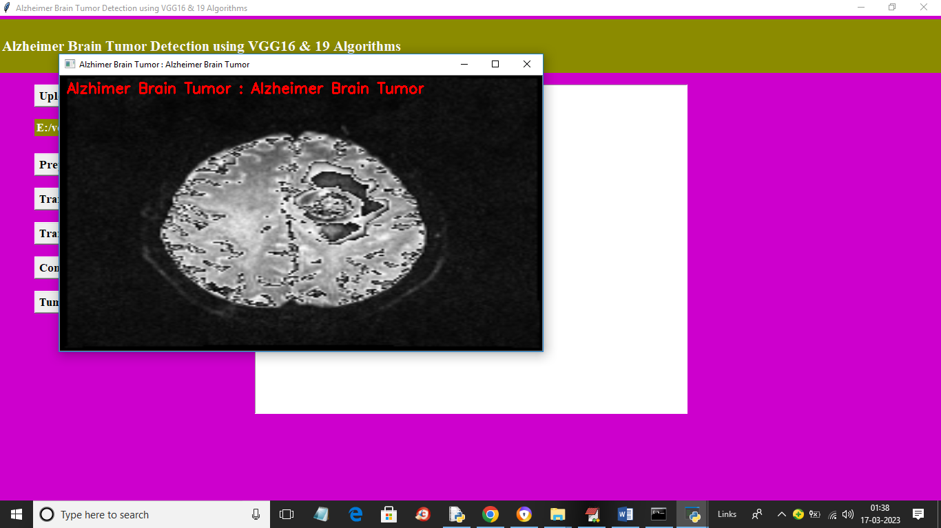

Slide 18
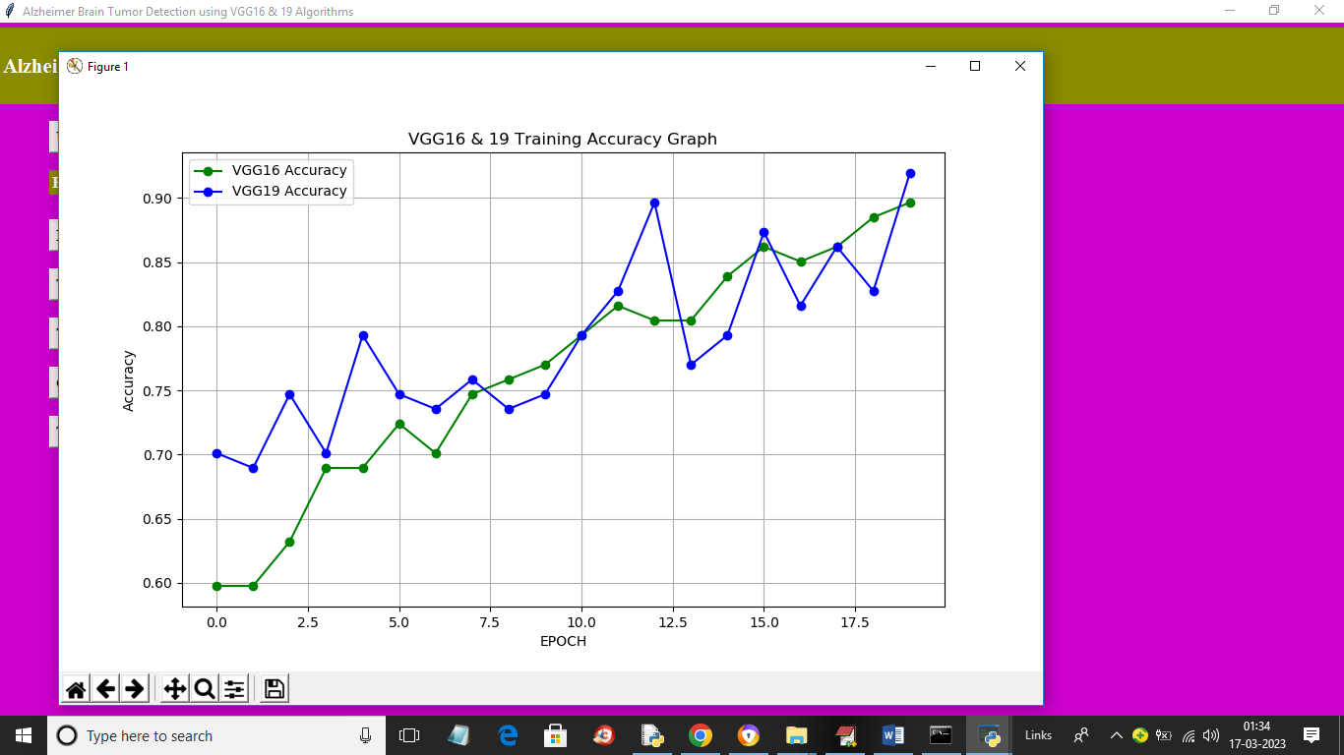
GRAPH:

Slide 19
Conclusion:
The proposed multi-disease detection system utilizing deep learning techniques for analyzing X-ray images represents a significant advancement in medical diagnostics.
By integrating a robust deep learning architecture with transfer learning and multi-label classification capabilities, the system addresses the critical challenges faced by existing models, such as data limitations and lack of interpretability.
As the healthcare landscape continues to evolve, this proposed framework offers a promising solution for improving patient care and enhancing clinical decision-making,

Slide 20
Future Scope:
Improved Accuracy & Generalization – Larger datasets, transfer learning, better optimization.
Advanced AI Integration – Multi-modal learning, explainable AI, federated learning.
Real-Time & Cloud-Based Deployment – Smart hospitals, mobile/web applications, edge computing.
Multi-Disease Expansion – Detecting fractures, osteoporosis, TB, and rare lung diseases.

Slide 21
References:
Jha, S., et al. (2020). "A Survey on Deep Learning Techniques for Medical Image Analysis." Journal of Healthcare Engineering, 2020.
Yamashita, R., et al. (2018). "Convolutional Neural Networks for Medical Image Analysis: Full Training or Fine Tuning?" IEEE Transactions on Medical Imaging, 37(1), 2018.
Alzubaidi, L., et al. (2021). "Review of Deep Learning Methods for Medical Image Analysis." Journal of Healthcare Engineering, 2021.
Yu, L., et al. (2019). "Multi-Disease Classification in Medical Imaging using Deep Learning." IEEE Access, 7, 12345-12356.

Slide 22
GitHub Link:
https://github.com/amrutha1405/Multi-disease-detection-system-with-X-Ray-Images-using-deep-learning-techniques

Slide 23
THANK YOU

